Slide 1
F

Slide 2
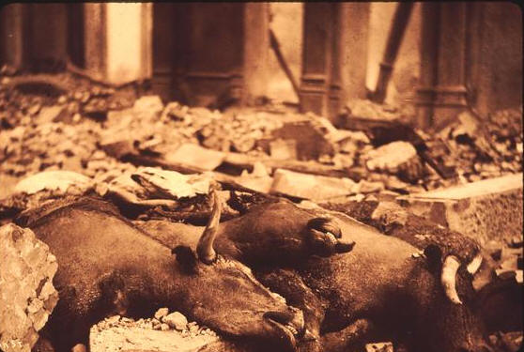
A

Slide 3
Animal
Just

Slide 4
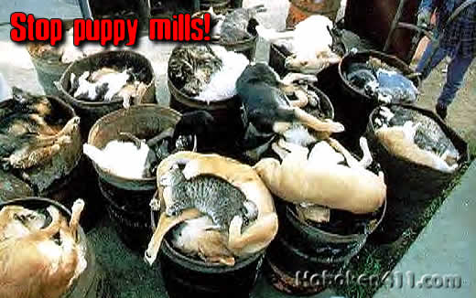
A

Slide 5
Animal
Just

Slide 6
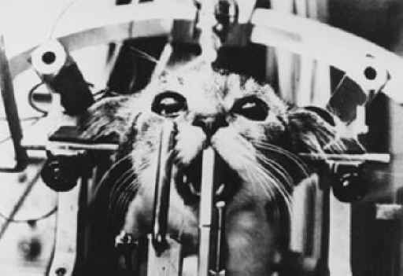
A

Slide 7
A
A

Slide 8
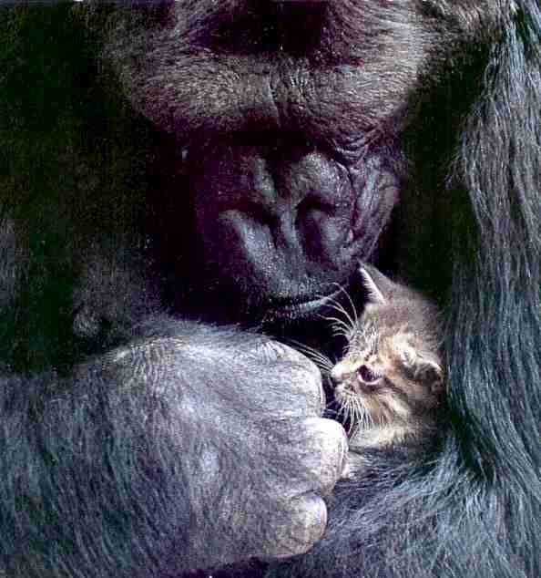
A

Slide 9
A
A

Slide 10
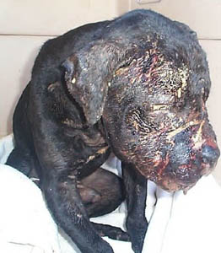
A

Slide 11
A
Q

Slide 12
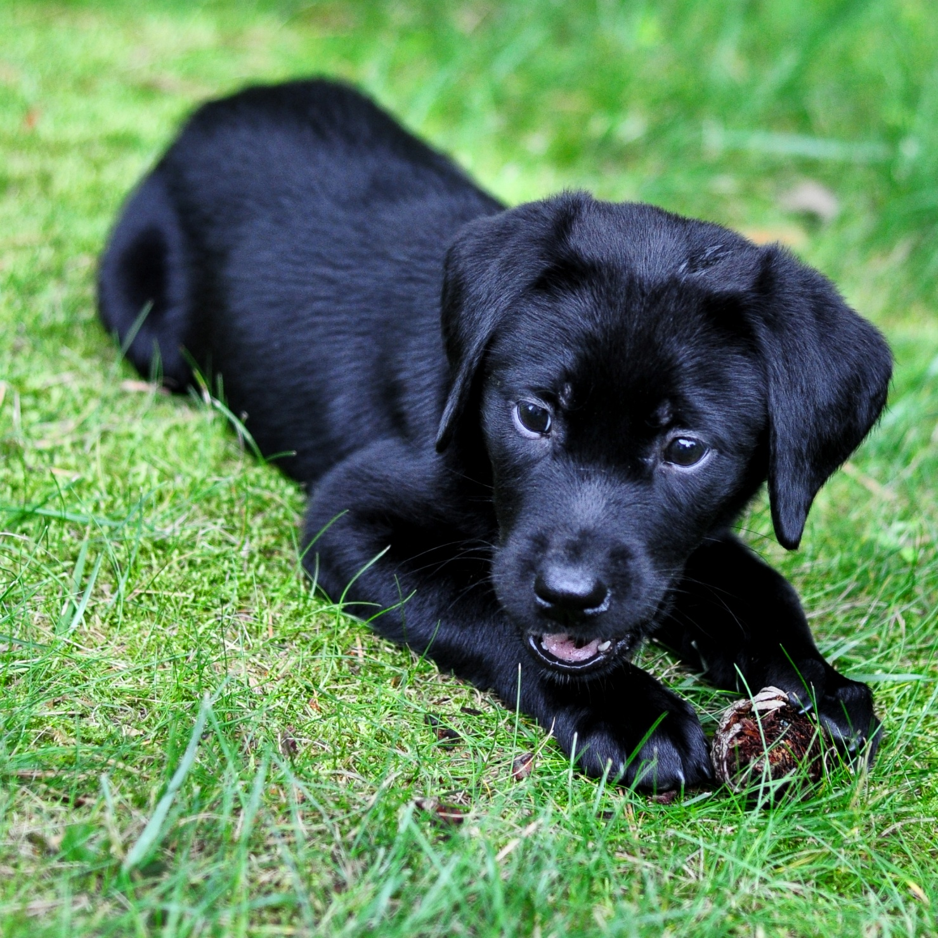
A

